Slide 1
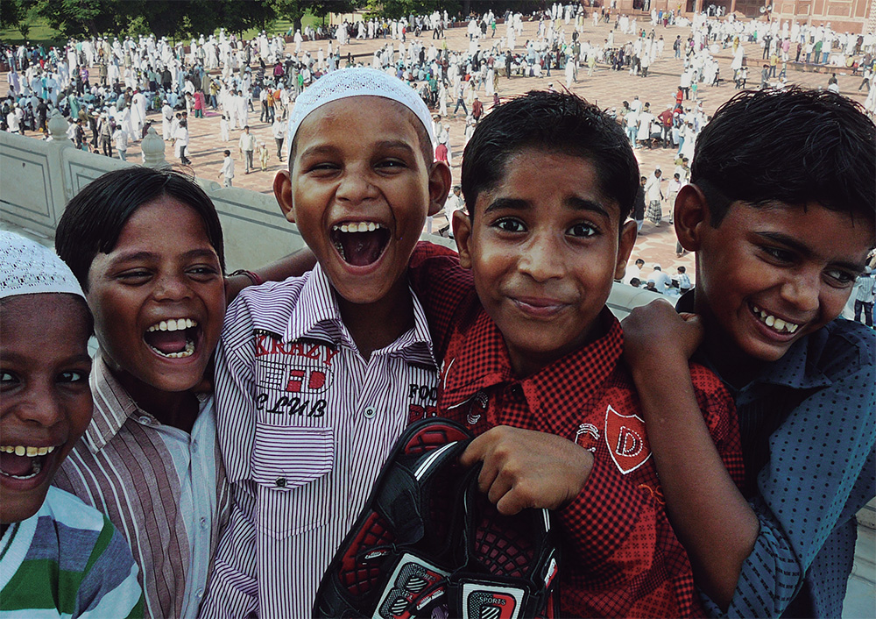

Slide 2
PLEASE REMEMBER
ME

Slide 3
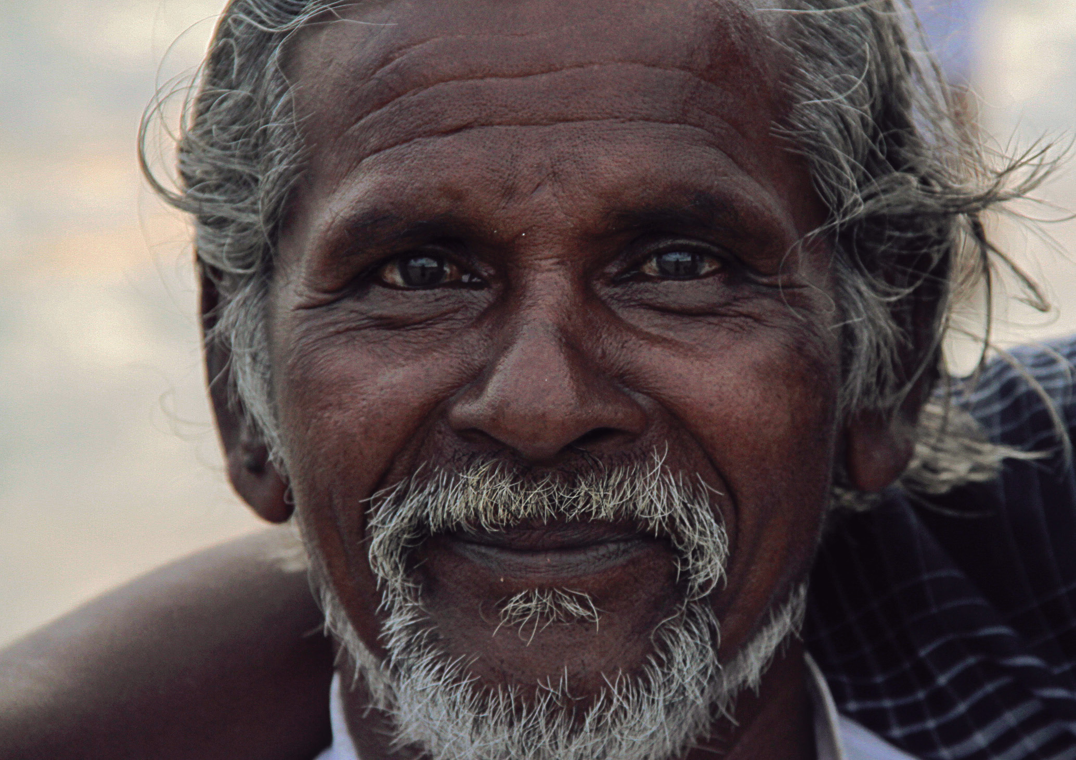
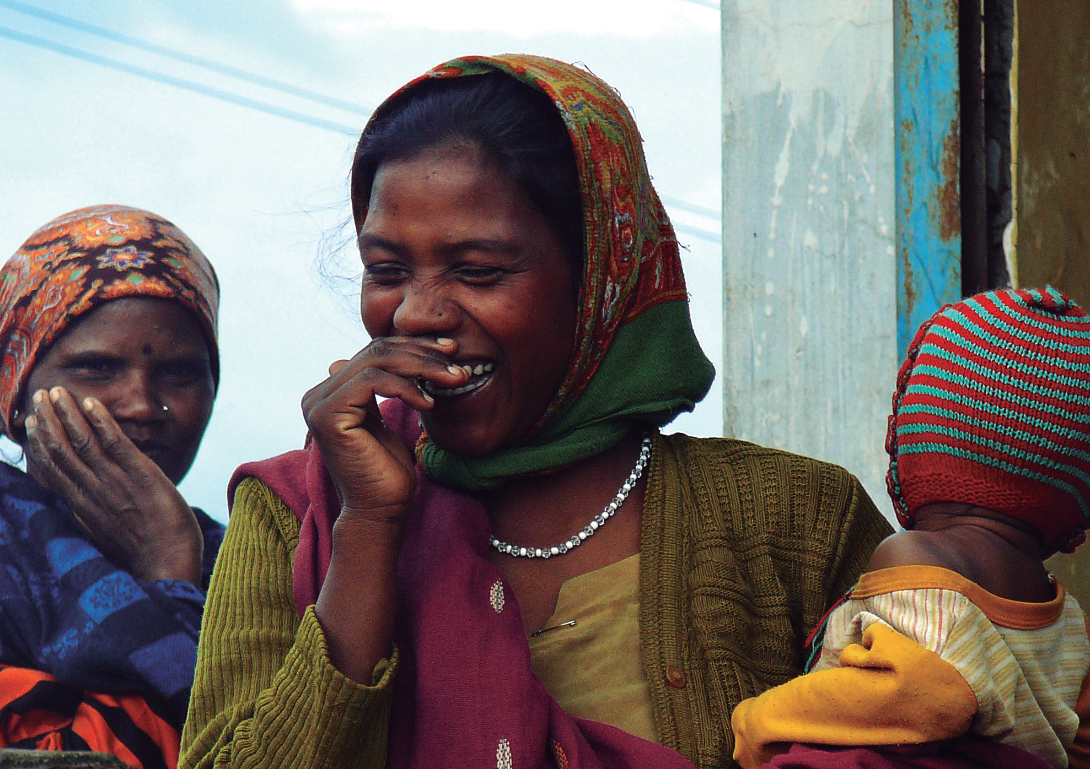
3 / 8
Please Remember Me is a photo book intended as a loving homage. Love for India, and for its people.

Slide 4
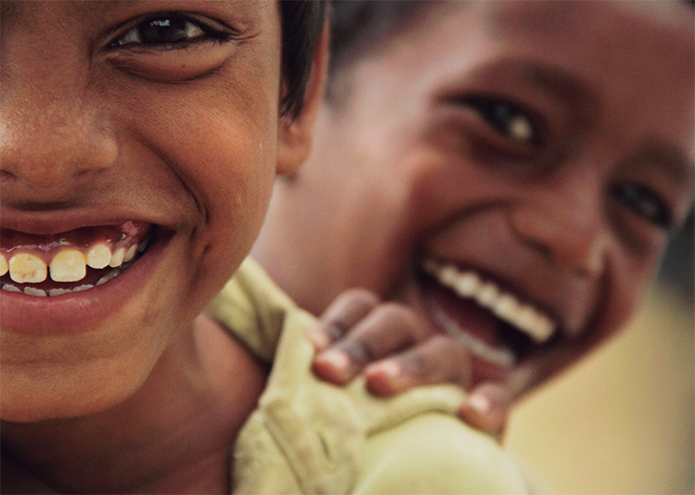
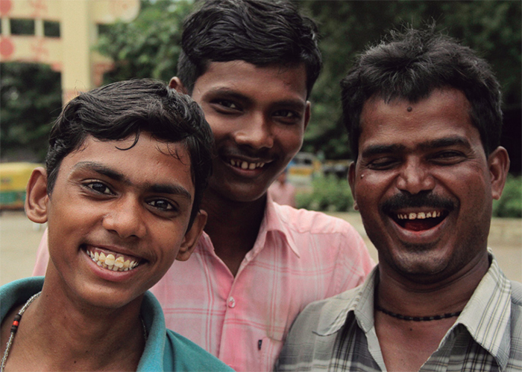
4 / 8
Probably the best synthesis of the book comes from its prologue:
“We are Lulu and Tif. We are a couple, and we traveled to India together. Landscapes, culture, food, climate were different at every step of the journey, but there was one constant. Everywhere we went, people asked us to take their picture. Not with us. Just theirs.
Normally, people would wave and leave afterwards. Nobody would ask to see the photo in the camera display. Or leave an address for us to send the picture later. Just a nod, a smile (always a smile!) and then they would dissapear.
Everyone, except for this one little girl. It was Eid, the celebration that marks the last day of Ramadan. We were invited to a house. The three daughters of the family jumped on Lulu as soon as they saw her and started tattooing her with henna and making her up. It was Eid, and she had to look beautiful. Of course, a picture had to be taken; with Lulu in the shot this time. Nobody left afterwards. Instead, this beautiful teenager said the words that marked our trip (and our lives, maybe) for ever: «Please remember me».
We’ve decided to make this book as an homage and tribute to all of those who asked to be remembered. Here it is.”

Slide 5
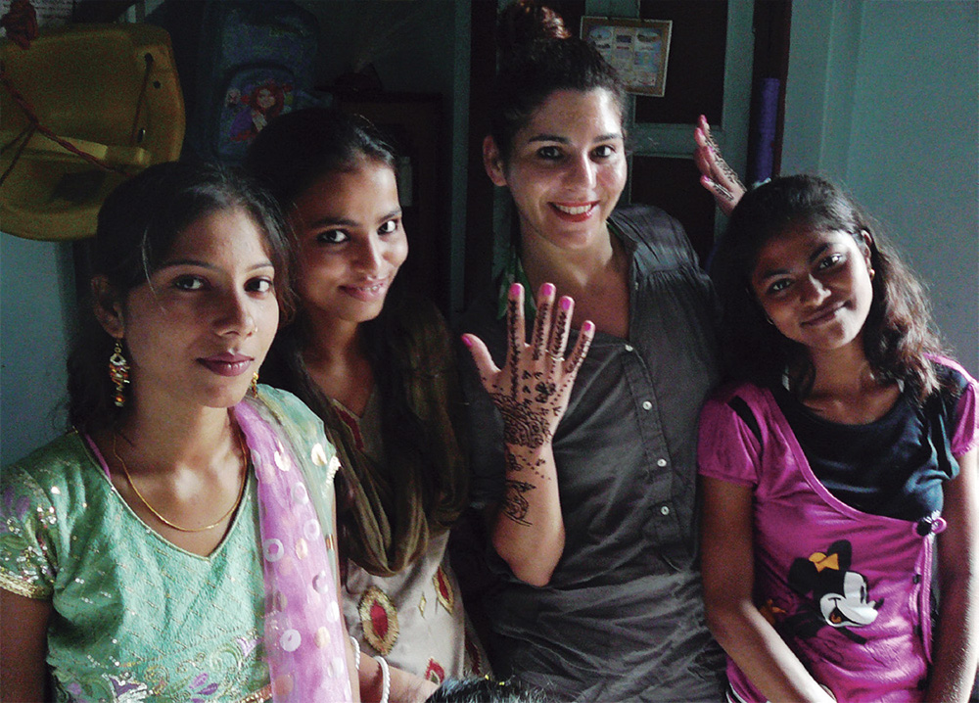
5 / 8
Lulu is a publisher and founding partner at Limonero, an independent publishing house with the purpose of bringing beautiful illustrated books both to young and adult audiences. http://www.limonero.com.ar/en
Tif is a film director and producer. He’s the founder and Executive Producer of El Rio, a multidisciplinary production company based in Buenos Aires with sister companies scattered all over Latin America. http://www.elrio.tv

